Slide 1






Digital Academix’s
Project
Presented by: Nikolay Zhelyazkov and Stefan Radev

Slide 2

Overview
Team
Our concept
Realization
Used Technologies

Slide 3
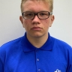
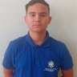
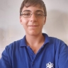
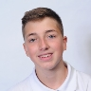
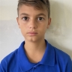
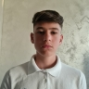


Team Members
Egor Gremennikov
BackEnd Programmer
Nikolay Zhelyazkov
BackEnd Programmer
Stefan Radev
BackEnd Programmer
Dimitur Byandov
BackEnd Programmer
Vicho Vichev
Scrum Trainer
Enis Mustafa
Scrum Trainer

Slide 4



Concept
Our idea is to actualize various quizzes with enough difficulty to think. At the end of the questions , the user’s device will calculate how many questions were answered correctly , at the maximum points of 10.

Slide 5





topic
Realization
Idea
Visualise
Finalization
At the first week , we had to think of a topic. The best one was voted by everyone
We started to construct the idea by writing the main structure of the code and questions.
Finishing Documentary , creating a Presentation and finishing README.

Slide 6













Resource page

Slide 7

Let us get Into the Program!

